Slide 1



VELOCITY
VEHICLES
Speed into savings with your perfect car
PRESENTED BY:
Byte Warriors

Slide 2



Meet our team
09/10
Aniket Pal
Aditya Raj
Pierrs I K
Team Lead
Java , python spring boot, angular, Deep learning, selenium
Java, spring, springboot, ReactJS, MySQL
java, Python , C,
MySQL, sprinboot,
ML, LLM’s

Slide 3
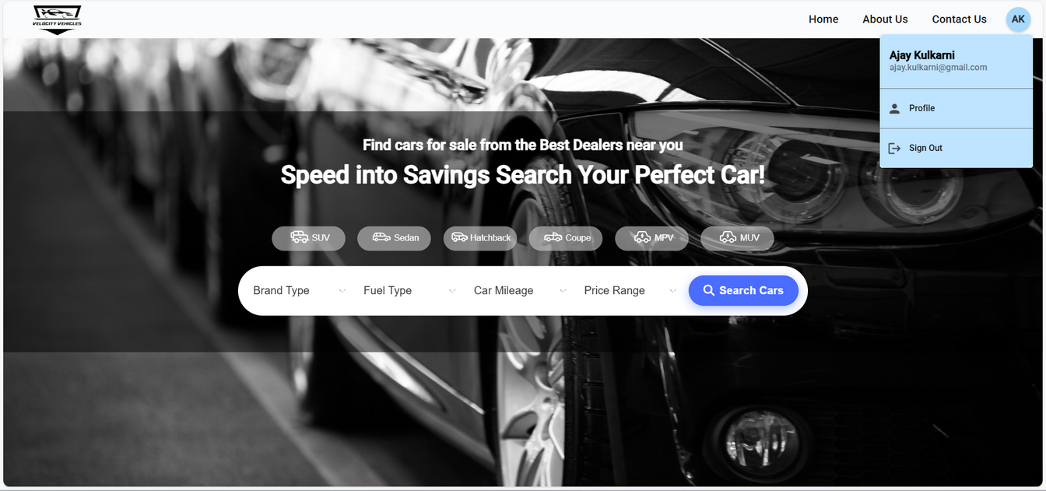
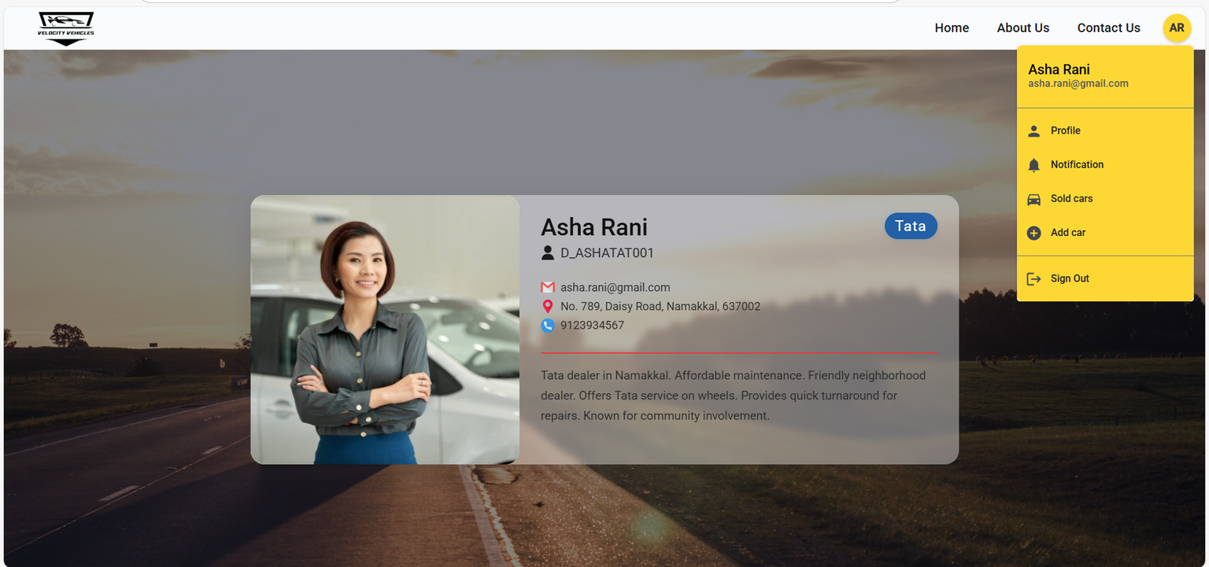
01
The Functional Requirements include an interactive home page with navigation links and filters, detailed sections for exploring cars, and distinct user roles for customers and dealers.
03/10
Project
Overview
02
The Technical Design uses MySQL, Java Spring Boot, and Angular. It features a well-structured database and a layered backend architecture for scalability and maintainability.
Velocity Vehicles is a web-based application designed for an auto shop, facilitating car exploration, comparison, and management for both customers and dealers. The platform aims to provide a seamless and efficient experience with a secure backend, intuitive UI, and responsive design.
03
The User Interface is user-friendly and responsive, with a scrollable home page, detailed car specifications, and easy sign-up and login processes for users and dealers.
Byte Warriors

Slide 4


04/10
Project Initiation
The project was initiated by our trainer, providing us with a simple problem statement that aimed to let us explore java programming concepts such as interfaces, abstract and collections.
The project was then extended for the final assessment, for which we followed proper product development lifecycle.
FRD
TDD
LINK TO FRD
LINK TO TDD

Slide 5
Functionalities
These are the list of functionalities that are avalible to the end user in our application.
Filter by
Customer Login
Customer Register
Buy Car
Book Test Drive
View Car Details
Search Cars
View Profile
Dealer Login
Dealer Register
View Cars
Add Cars
View Sold Cars
View Sales
Dashboard
price
mileage
fuel
transmission
brand
color & more

Slide 6
08/10
Exception
Handling
List of
Custom Exceptions
In our application we have multiple custom exceptions that try to cover any and all failures and edge cases.
To handle all those exceptions that might arise and provide the right response we have the GlobalExceptionHandler class that provides a single point of contact to all the exceptions that might arise.
This helps code readability, understanding and allows us to add and update exceptions much more easily in the future.
CarNotFoundException
CarBrandNotFoundException
CustomerNotFoundException
DealerNotFoundException
DuplicateEmailException
DuplicatePhoneException
DuplicateUsernameException
InvalidCarStatusException
InvalidSalesDataException
SalesNotFoundException

Slide 7

05/10
Security
The security for our project was implemented with spring security. We have done so due to spring security’s ease of integration within the project.
Configuring Security: Setting up security configurations to protect URLs and endpoints, using SecurityFilterChain.
Authentication: Implementing form based login and JWT (JSON Web Token) for user authentication.
Database Authentication
JWT token implementation
JWTUtil: A utility class created to generate and validate JWT tokens.
Token Generation: Upon successful login, a JWT token is generated and returned to the client.
Token Validation: The JWT token is validated to ensure the user is authenticated and authorized to access the resource.
User Details Service: A custom UserDetailsService implementation is created to load user-specific data from the database.
Password Encoding: Passwords are securely hashed using a PasswordEncoder (BCrypt).
Authentication Manager: Configured to use the custom UserDetailsService and PasswordEncoder for authentication.

Slide 8
Frontend
The frontend of our project is developed with Angular to deliver an efficient, component-based single-page application.
Component Based architecture
Services and DTO’s
Auth
The application has various services, each used to contact and communicate with various api endpoints.
The DTO’s provide a way for us to store, transfer and serve data in our applicarion
The application authenticates users to distinguish them as either a CUSTOMER or DEALER.
Every part of the application is built as an component so that we can easily and effiently navigate errors and increase code maintainablility

Slide 9
10/10
Thank you
BYTE WARRIORS
Aniket Pal
Aditya Raj
Pierrs I K

